Slide 1
Two New Passive Circuit Elements
Recall that resistors are called passive elements because they cannot generate electrical energy.
The two other common passive elements are capacitors and inductors.
Resistors dissipate energy as heat, but capacitors and inductors store energy, which can later be returned to the circuit.

Slide 2

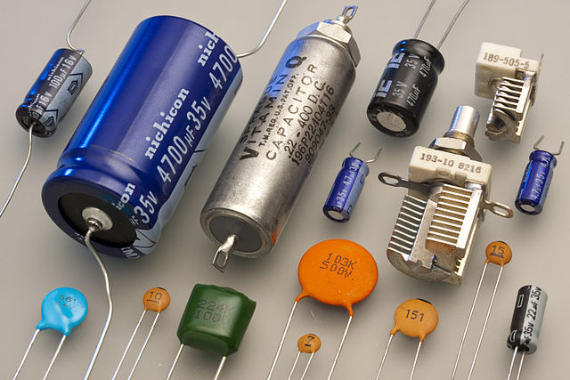
Capacitors
A capacitor is a passive device designed to store energy in its electric field.
Image from Wikipedia.

Slide 3
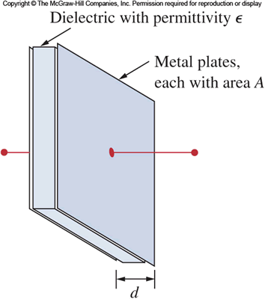
Parallel-Plate Capacitor
A capacitor typically consists of two metal plates separated by an insulator.
The insulator between the plates is called the dielectric.

Slide 4
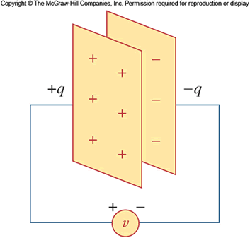
Charging a Capacitor
When a capacitor is connected across a voltage source, charge flows between the source and the capacitor’s plates until the voltage across the capacitor is equal to the source voltage.
In this process, one plate becomes positively charged, and the other plate becomes negatively charged.

Slide 5
Units of Capacitance
Capacitance is the measure of a capacitor’s ability to store charge.
Capacitance is abbreviated C.
The unit of capacitance is the farad (F).
Typical capacitors found in electronic equipment are in the picofarad (pF), nanofarad (nF), or microfarad (μF) range.

Slide 6
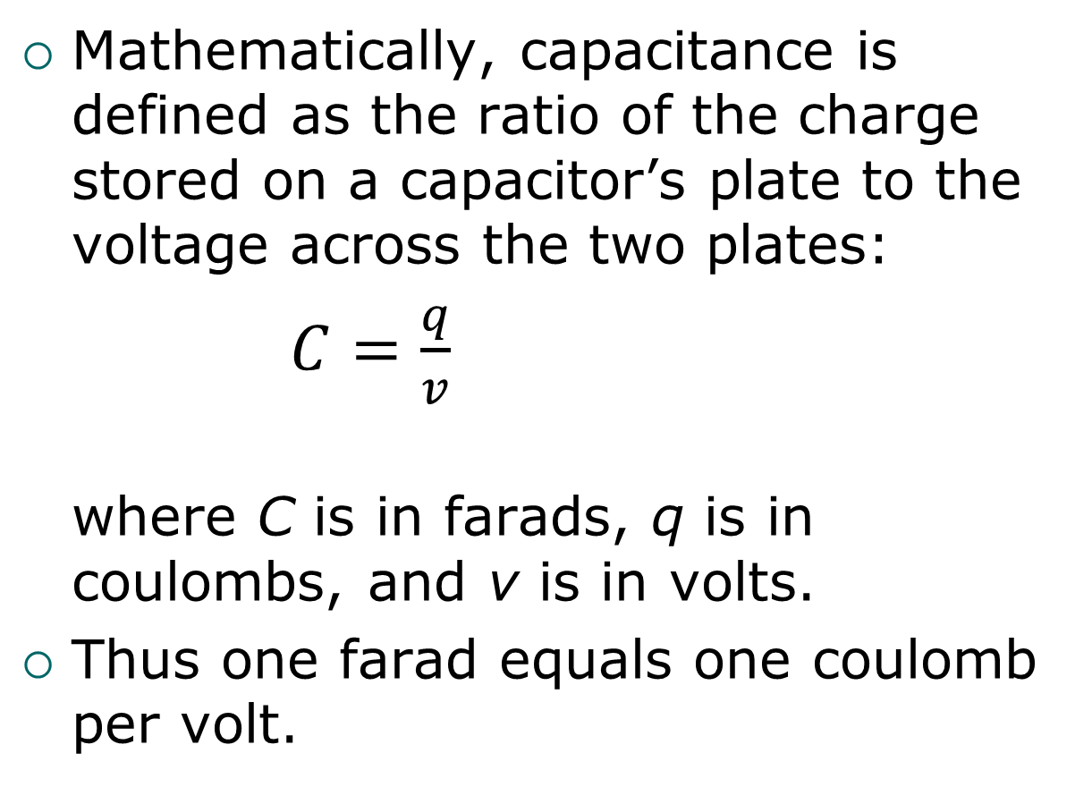
Capacitance = Charge per Voltage
Mathematically, capacitance is defined as the ratio of the charge stored on a capacitor’s plate to the voltage across the two plates:
$C=\frac{q}{v}$
where C is in farads, q is in coulombs, and v is in volts.
Thus one farad equals one coulomb per volt.

Slide 7
Capacitor Types
Capacitors can be classified by the materials used for their dielectrics (such as air, paper, tantalum, ceramic, plastic film, mica, electrolyte).
Each type has its own tradeoffs in practical use.
Variable capacitors are also available.

Slide 8
Electrolytic Capacitors (1 of 2)
Electrolytic capacitors are available in very large values, such as 100,000 μF.
Unlike other capacitors, they are polarized: one side must remain positive with respect to the other.
Therefore . . .
Arrow printed on the case points toward negative lead.

Slide 9
Electrolytic Capacitors (2 of 2)
You must insert electrolytic capacitors in the proper direction. Inserting them backwards can result in injury or in damage to equipment.

Slide 10
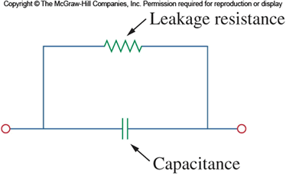
Capacitors Store Energy
Recall that energy is dissipated as heat when current flows through a resistance.
An ideal capacitor does not dissipate energy. Rather it stores energy, which can later be returned to the circuit.
We can model a real, non-ideal capacitor by including a resistance in parallel with the capacitance.

Slide 11
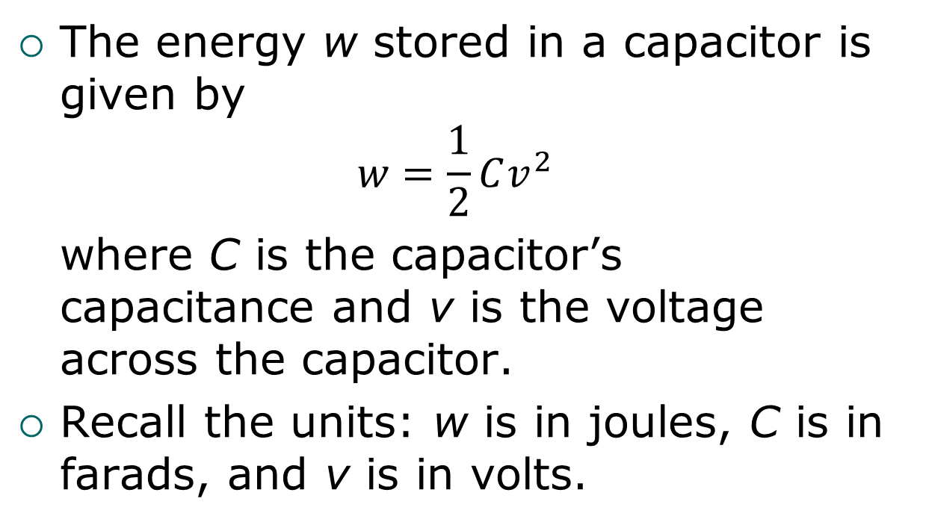
Capacitor Energy Equation
The energy w stored in a capacitor is given by
$$w=\frac{1}{2}Cv^{2}$$
where C is the capacitor’s capacitance and v is the voltage across the capacitor.
Recall the units: w is in joules, C is in farads, and v is in volts.

Slide 12
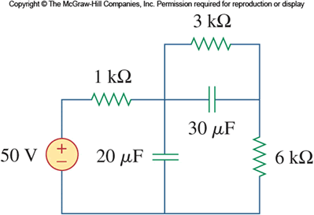
DC Conditions in a Circuit with Capacitors
When power is first applied to a circuit like the one shown, voltages and currents change briefly as the capacitors “charge up.”
But once the capacitors are fully charged, all voltages and currents in the circuit have constant values.
We use the term “dc conditions” to refer to these final constant values.

Slide 13
Capacitors Act Like Opens
Under dc conditions, a capacitor acts like an open circuit.
So to analyze a circuit containing capacitors under dc conditions, replace all capacitors with open circuits.
Later we’ll look at how to analyze such circuits during the “charging-up” time. (It’s trickier!)

Slide 14
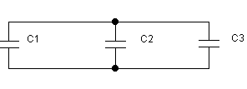
Capacitors in Parallel: Equivalent Capacitance
The equivalent capacitance of capacitors in parallel is the sum of the individual capacitances:
C_{eq} = C₁ + C₂ + C₃ + ... + C_{N}
Similar to the formula for resistors in series.

Slide 15
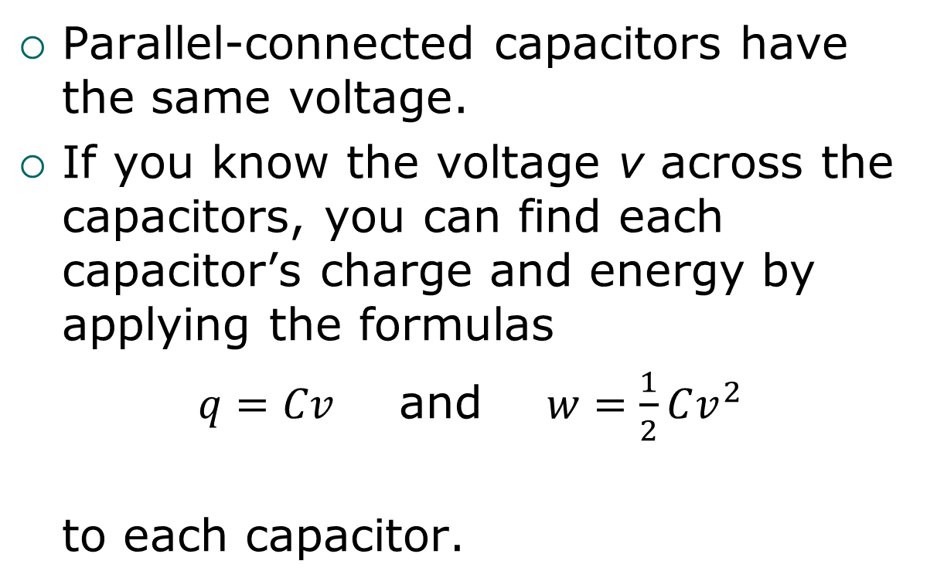
Capacitors in Parallel: Voltage, Charge, and Energy
Parallel-connected capacitors have the same voltage.
If you know the voltage v across the capacitors, you can find each capacitor’s charge and energy by applying the formulas
$q=Cv$ and $w=\frac{1}{2}Cv^{2}$
to each capacitor.

Slide 16

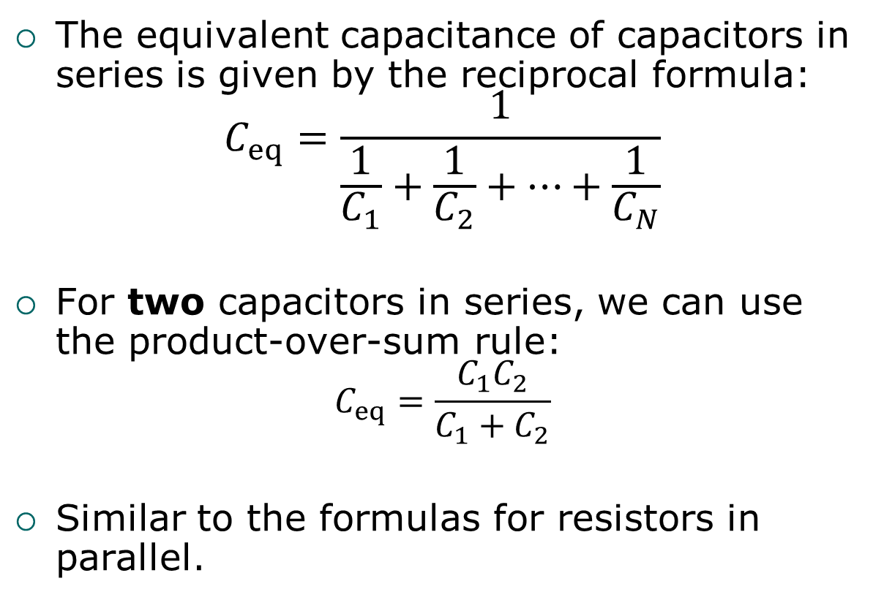
Capacitors in Series: Equivalent Capacitance
The equivalent capacitance of capacitors in series is given by the reciprocal formula:
$$C_{eq}=\frac{1}{\frac{1}{C_{1}}+\frac{1}{C_{2}}+…+\frac{1}{C_{N}}}$$
For two capacitors in series, we can use the product-over-sum rule:
$$C_{eq}=\frac{C_{1}C_{2}}{C_{1}+C_{2}}$$
Similar to the formulas for resistors in parallel.

Slide 17
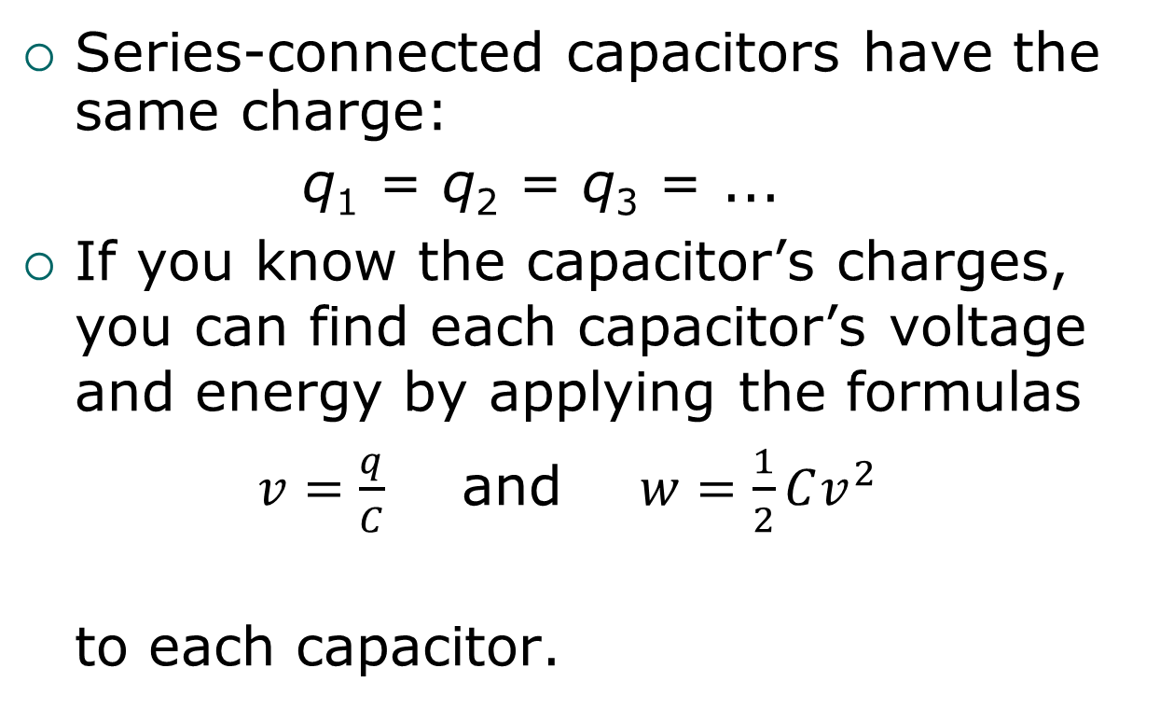
Capacitors in Series: Charge, Voltage, and Energy
Series-connected capacitors have the same charge:
q₁ = q₂ = q₃ = ...
If you know the capacitor’s charges, you can find each capacitor’s voltage and energy by applying the formulas
$v=\frac{q}{C}$ and $w=\frac{1}{2}Cv^{2}$
to each capacitor.

Slide 18
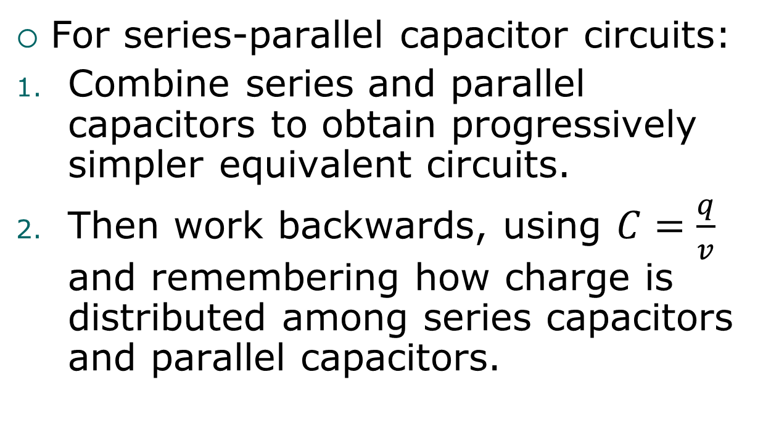
Series-Parallel Capacitors
For series-parallel capacitor circuits:
Combine series and parallel capacitors to obtain progressively simpler equivalent circuits.
Then work backwards, using $C=\frac{q}{v}$ and remembering how charge is distributed among series capacitors and parallel capacitors.

Slide 19
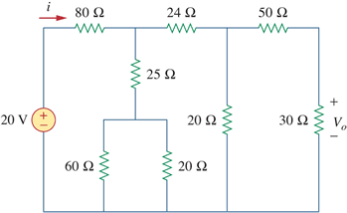
Constant Voltages and Currents
In circuits that we’ve analyzed up to now, voltages and currents have been constant as time passes.
Example: In this circuit, the source voltage is constant (20 V) and the current i is constant (200 mA).

Slide 20
Graphs of Constant Values Versus Time
Up to now we haven’t used graphs of voltage versus time or of current versus time. With constant voltages and currents, such graphs wouldn’t be very interesting.
Example: Here’s a graph of source voltage versus time for the circuit on the previous slide.

Slide 21
Changing Voltages and Currents
In many cases, voltages and currents in a circuit change as time passes.
We use two ways of describing these changing values:
Using an equation, such as v(t) = 8t V.
Using a graph, such as:

Slide 22
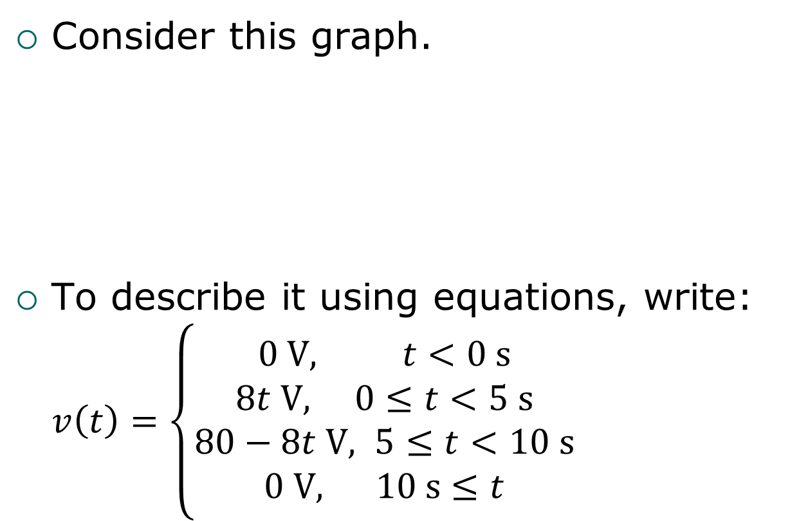
A More Complicated Example
Consider this graph.
To describe it using equations, write: $v\left(t\right)=\left\{\begin{aligned}0 V, t<0 s \\ &8t V, 0≤t<5 s \\ 80−8t V, 5≤t<10 s \\ 0 V, 10 s≤t\end{aligned}\right.$

Slide 23
Current-Voltage Equations
Key equations for any circuit element are the equations that relate the element’s current to its voltage.
For resistors, these are purely algebraic equations, as given by Ohm’s law, which we’ll review on the next slide.
But for capacitors and inductors, the equations involve derivatives and integrals.

Slide 24
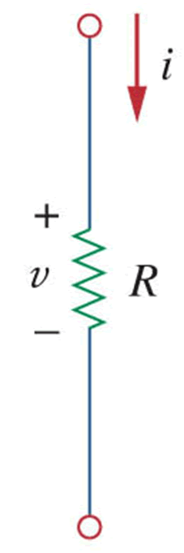


Review of Equations for a Resistor
Recall that for a resistor, we have
Let’s call that the current-voltage equation for a resistor.
And a resistor’s voltage-current equation is
These equations involve only algebraic operations (division and multiplication).
Both equations assume the passive sign convention (current flows into the positive end).
$$i=\frac{v}{R}$$
$$v=iR$$

Slide 25
Changing Voltages and Currents in Resistors
Since a resistor’s voltage and current are directly proportional to each other, it’s easy to find one when given the graph or equation of the other.
Example: Suppose a 4-kΩ resistor’s voltage is v(t) = 8t V:
Then the resistor’s current is i(t) = 2t mA:

Slide 26

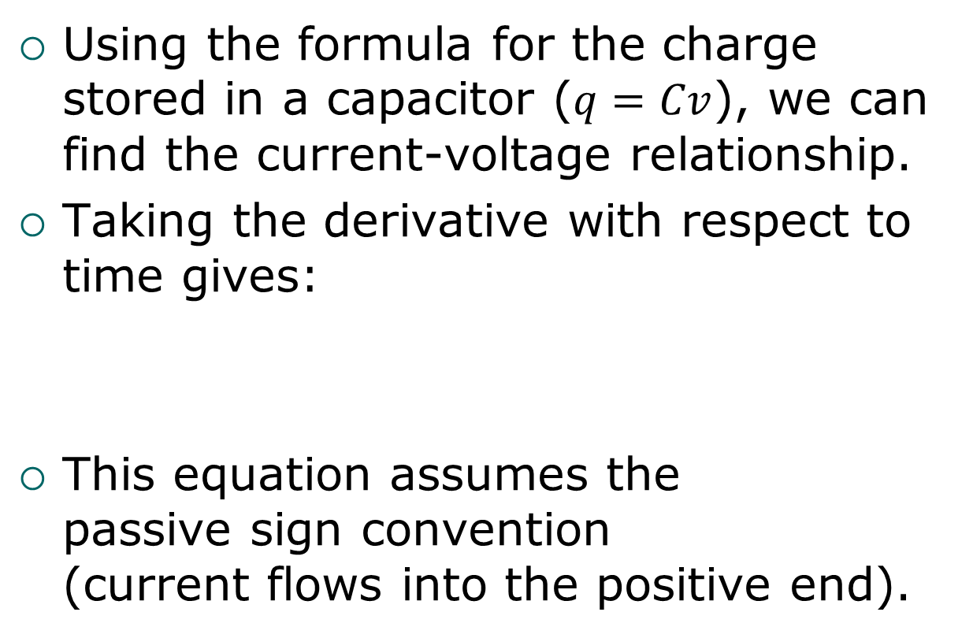
Current-Voltage Relationship for a Capacitor
Using the formula for the charge stored in a capacitor ($q=Cv$), we can find the current-voltage relationship.
Taking the derivative with respect to time gives:
This equation assumes the passive sign convention (current flows into the positive end).

Slide 27
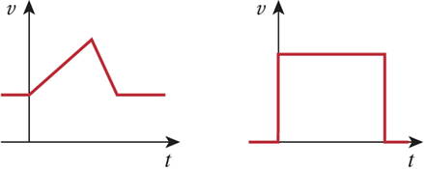
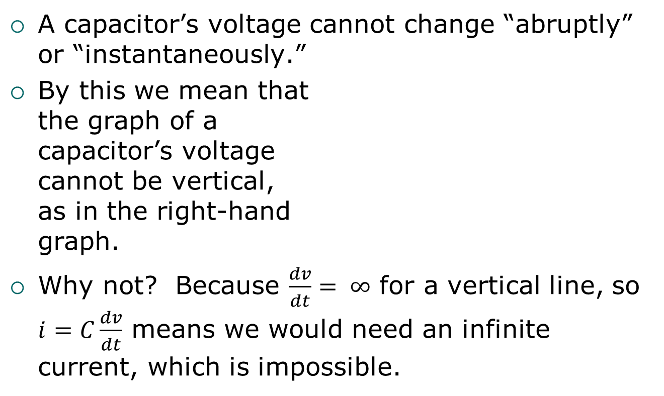
No Abrupt Voltage Changes for Capacitors
A capacitor’s voltage cannot change “abruptly” or “instantaneously.”
By this we mean that the graph of a capacitor’s voltage cannot be vertical, as in the right-hand graph.
Why not? Because $\frac{dv}{dt}= ∞$ for a vertical line, so $i=C\frac{dv}{dt}$ means we would need an infinite current, which is impossible.
Allowed
Not Allowed!

Slide 28

Voltage-Current Relationship for a Capacitor
By integrating the current-voltage equation, $i(t)=C\frac{dv}{dt}$, we can find the voltage-current equation for a capacitor:

Slide 29

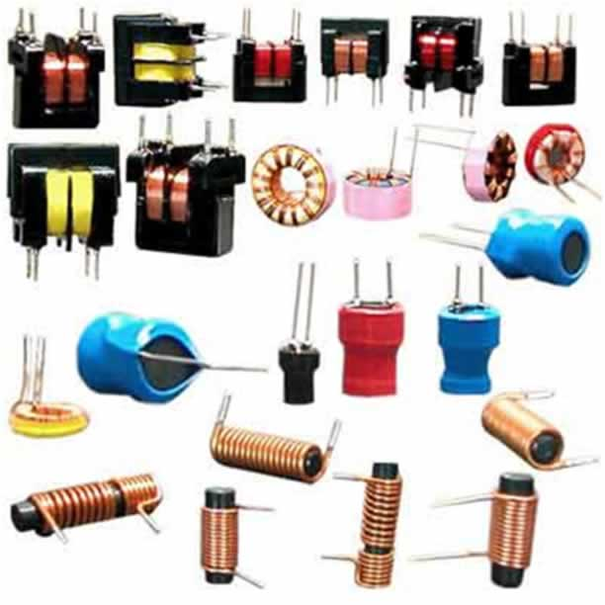
Inductors
An inductor is a passive device designed to store energy in its magnetic field.
Image from Wikipedia.

Slide 30
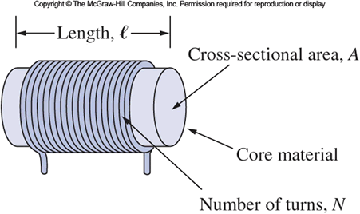
Building an Inductor
An inductor typically consists of a cylindrical coil of wire wound around a core, which is a rod usually made of an iron alloy.

Slide 31
Inductance
When the current in a coil increases or decreases, a voltage is induced across the coil that depends on the rate at which the current is changing.
The polarity of the voltage is such as to oppose the change in current.
This property is called self-inductance, or simply inductance.

Slide 32
Units of Inductance
Inductance is abbreviated L.
The unit of inductance is the henry (H).
Typical inductors found in electronic equipment are in the microhenery (μH) or millihenry (mH) range.

Slide 33
Inductor Types
Inductors are classified by the materials used for their cores.
Common core materials are air, iron, and ferrites.
Variable inductors are also available.

Slide 34
Chokes and Coils
Inductors used in high-frequency (ac) circuits are often called chokes.
Inductors are also sometimes simply called coils.

Slide 35
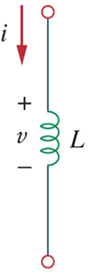

Voltage-Current Relationship for an Inductor
The voltage across an inductor is proportional to the rate of change of the current through it:
This equation assumes the passive sign convention (current flows into the positive end).
$$v=L\frac{di}{dt}$$

Slide 36
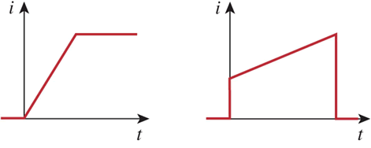
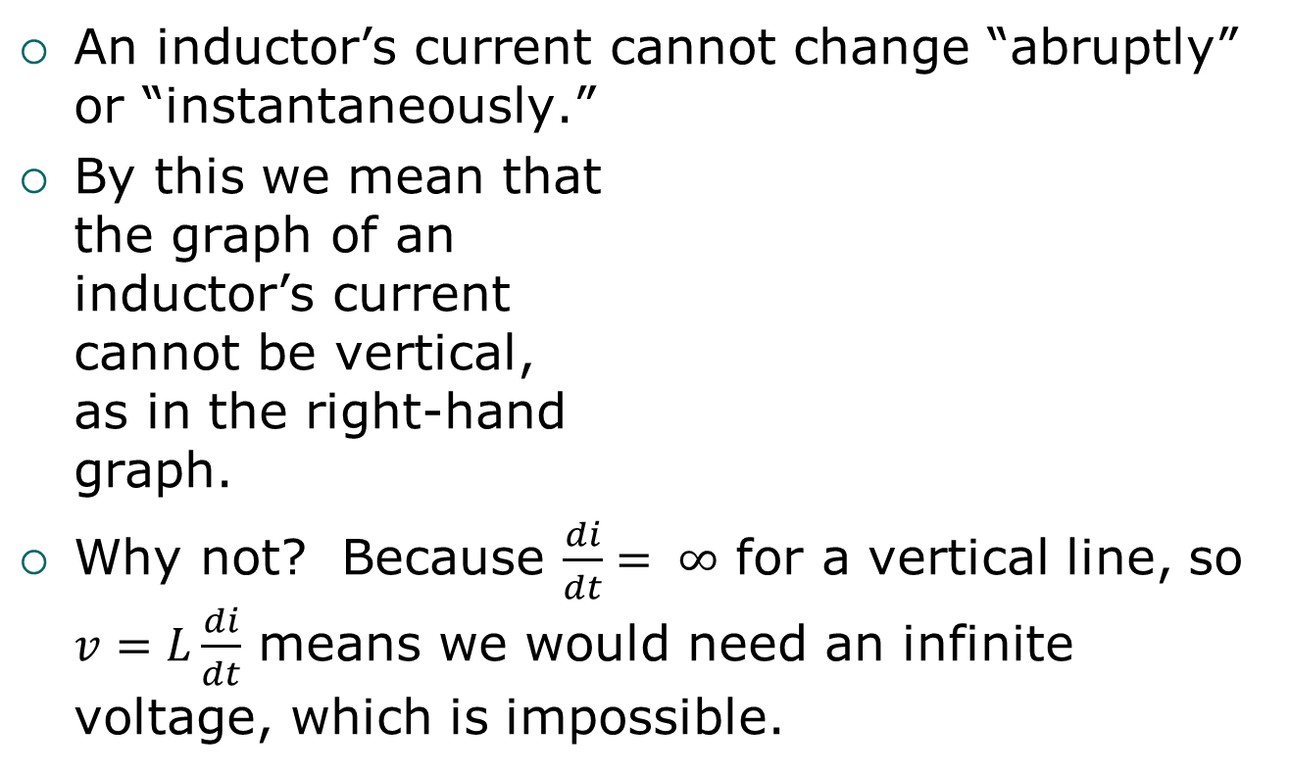
No Abrupt Current Changes for Inductors
An inductor’s current cannot change “abruptly” or “instantaneously.”
By this we mean that the graph of an inductor’s current cannot be vertical, as in the right-hand graph.
Why not? Because $\frac{di}{dt}= ∞$ for a vertical line, so $v=L\frac{di}{dt}$ means we would need an infinite voltage, which is impossible.
Allowed
Not Allowed!

Slide 37

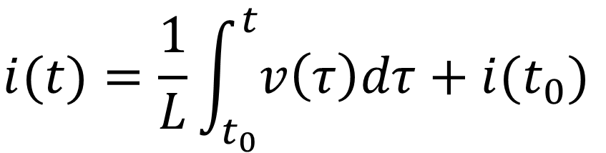
Current-Voltage Relationship for an Inductor
By integrating the voltage-current equation, $v(t)=L\frac{di}{dt}$, we can find the current-voltage equation for an inductor:
$$i(t)=\frac{1}{L}\int_{t_{0}}^{t}{v\left(τ\right)dτ+i(t_{0})}$$

Slide 38
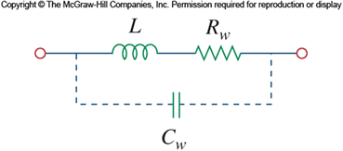
Inductors Store Energy
Recall that energy is dissipated as heat when current flows through a resistance.
An ideal inductor does not dissipate energy. Rather it stores energy, which can later be returned to the circuit.
We can model a real, non- ideal inductor by including a resistance in series with the inductance (and, for greater accuracy, a parallel capacitance).

Slide 39
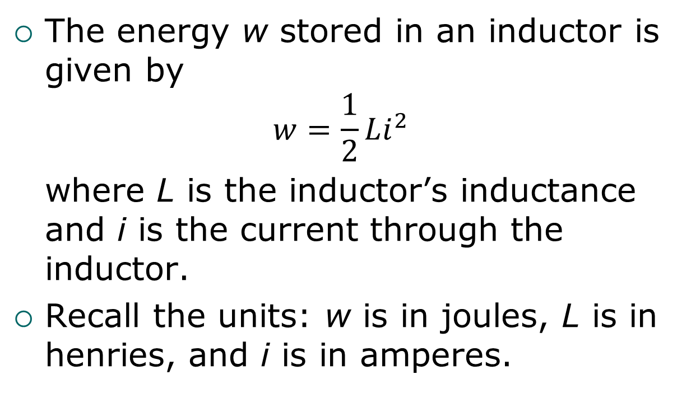
Inductor Energy Equation
The energy w stored in an inductor is given by
$$w=\frac{1}{2}Li^{2}$$
where L is the inductor’s inductance and i is the current through the inductor.
Recall the units: w is in joules, L is in henries, and i is in amperes.

Slide 40
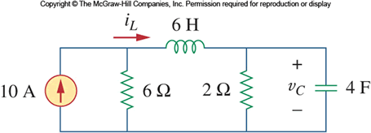
DC Conditions in a Circuit with Inductors or Capacitors
When power is first applied to a dc circuit with inductors or capacitors, voltages and currents change briefly as the inductors and capacitors become energized.
But once they are fully energized, all voltages and currents in the circuit have constant values.
Recall that we use the term “dc conditions” to refer to these final constant values.

Slide 41
Inductors Act Like Shorts
Under dc conditions, an inductor acts like a short circuit.
So to analyze a circuit containing inductors under dc conditions, replace all inductors with short circuits.
Later we’ll look at how to analyze such circuits during the time while the inductors and capacitors are being energized. (It’s trickier!)

Slide 42
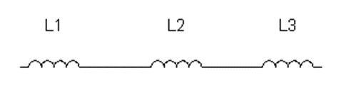
Inductors in Series: Equivalent Inductance
The equivalent inductance of inductors in series is the sum of the individual inductances:
L_{eq} = L₁ + L₂ + L₃ + ... + L_{N}
Similar to the formula for resistors in series.

Slide 43
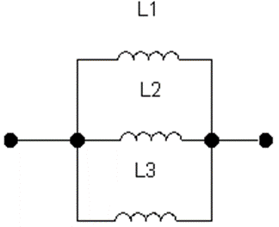
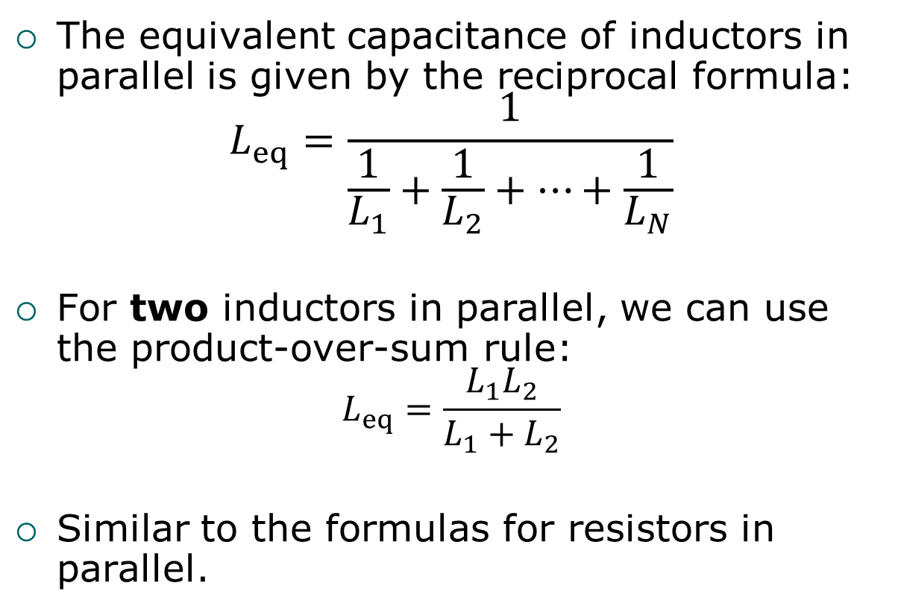
Inductors in Parallel: Equivalent Inductance
The equivalent capacitance of inductors in parallel is given by the reciprocal formula:
$$L_{eq}=\frac{1}{\frac{1}{L_{1}}+\frac{1}{L_{2}}+…+\frac{1}{L_{N}}}$$
For two inductors in parallel, we can use the product-over-sum rule:
$$L_{eq}=\frac{L_{1}L_{2}}{L_{1}+L_{2}}$$
Similar to the formulas for resistors in parallel.

Slide 44
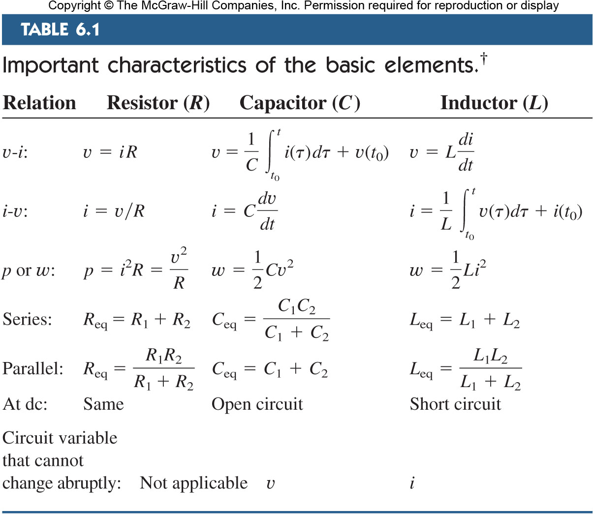
†Passive sign convention is assumed.

